Slide 1

Chapter 12
Multiple Access
12.<number>
Copyright © The McGraw-Hill Companies, Inc. Permission required for reproduction or display.

Slide 2

Figure 12.1 Data link layer divided into two functionality-oriented sublayers
12.<number>

Slide 3

Figure 12.2 Taxonomy of multiple-access protocols discussed in this chapter
12.<number>

Slide 4
12-1 RANDOM ACCESS
In random access or contention methods, no station is superior to another station and none is assigned the control over another. No station permits, or does not permit, another station to send. At each instance, a station that has data to send uses a procedure defined by the protocol to make a decision on whether or not to send.
Topics discussed in this section:
ALOHA
Carrier Sense Multiple Access
Carrier Sense Multiple Access with Collision Detection
Carrier Sense Multiple Access with Collision Avoidance
12.<number>

Slide 5

Figure 12.3 Frames in a pure ALOHA network
12.<number>

Slide 6

Figure 12.4 Procedure for pure ALOHA protocol
12.<number>

Slide 7
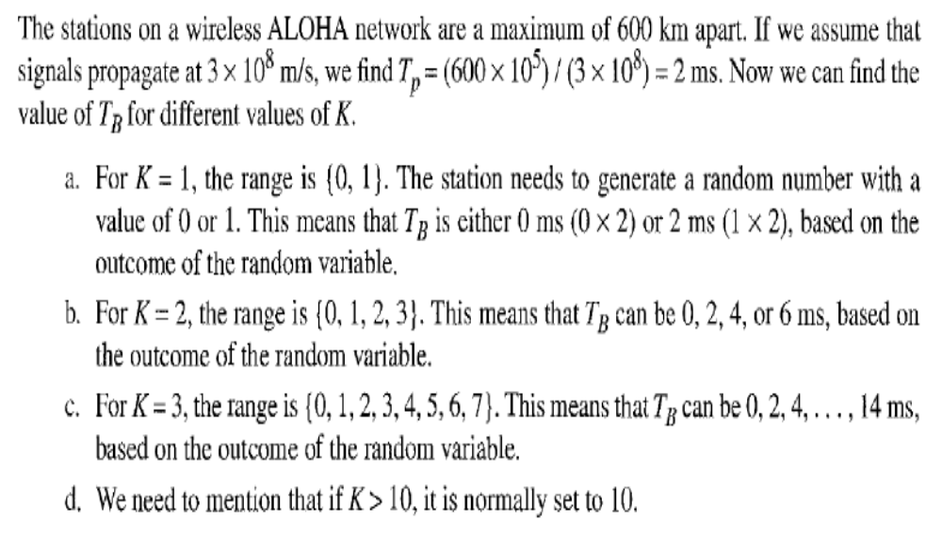
12.<number>

Slide 8
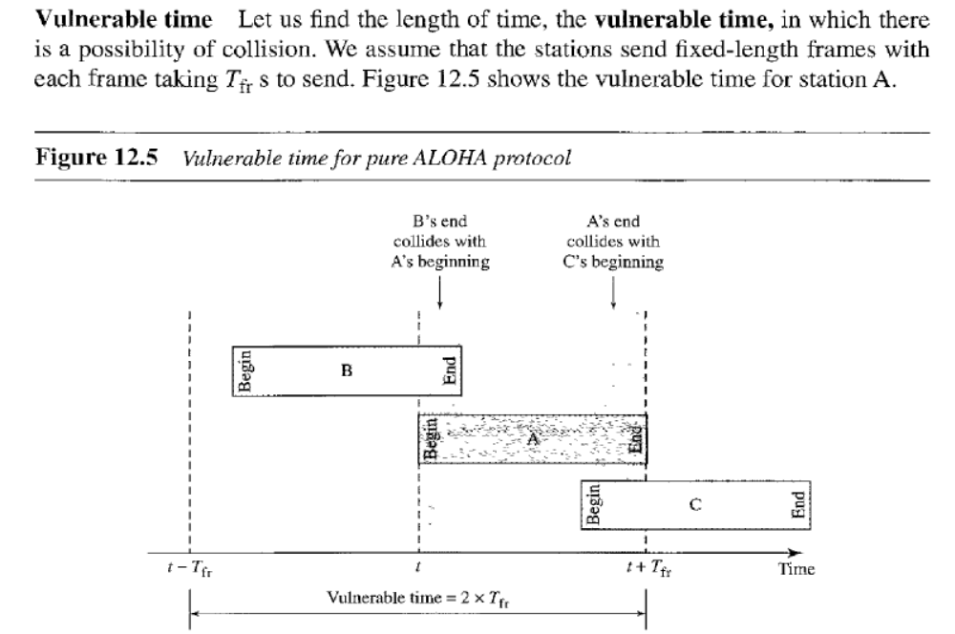
12.<number>

Slide 9
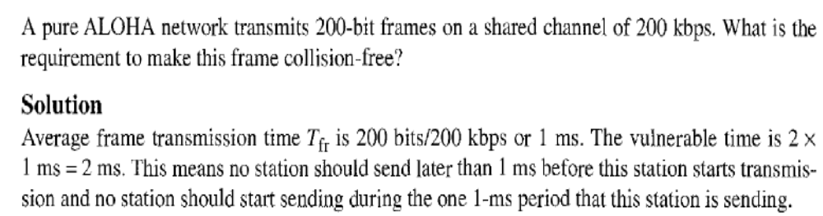
12.<number>

Slide 10
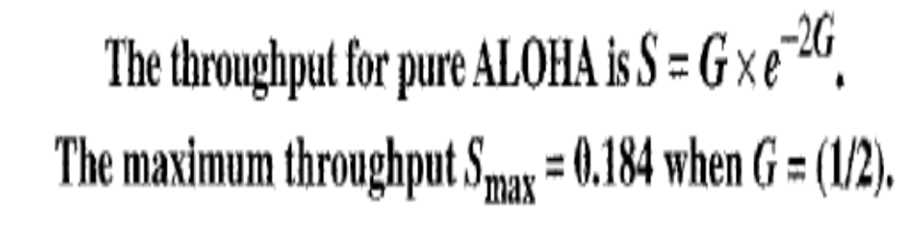

Slide 11
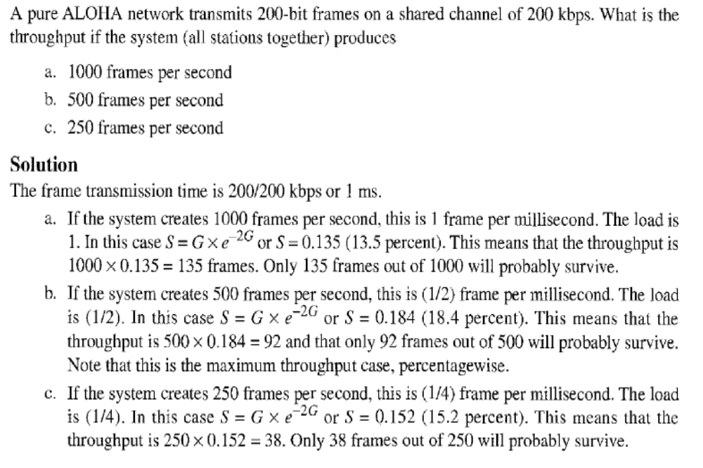

Slide 12

Figure 12.6 Frames in a slotted ALOHA network
12.<number>

Slide 13

Figure 12.7 Vulnerable time for slotted ALOHA protocol
12.<number>

Slide 14
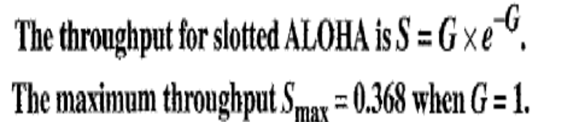

Slide 15
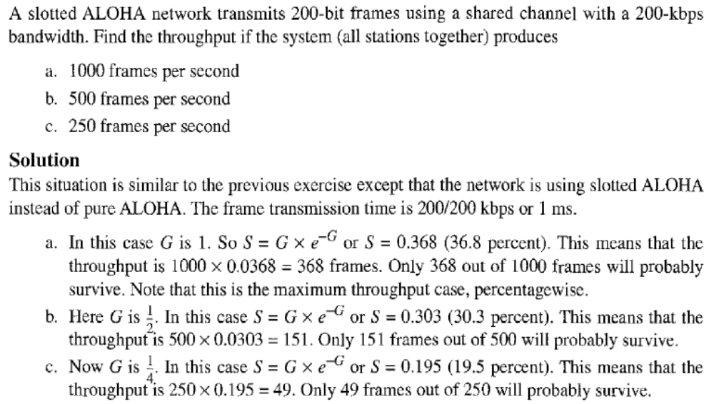

Slide 16

Figure 12.9 Vulnerable time in CSMA
12.<number>

Slide 17

Figure 12.10 Behavior of three persistence methods
12.<number>

Slide 18

Figure 12.11 Flow diagram for three persistence methods
12.<number>

Slide 19

Figure 12.12 Collision of the first bit in CSMA/CD
12.<number>

Slide 20

Figure 12.13 Collision and abortion in CSMA/CD
12.<number>

Slide 21
Example 12.5
A network using CSMA/CD has a bandwidth of 10 Mbps. If the maximum propagation time (including the delays in the devices and ignoring the time needed to send a jamming signal, as we see later) is 25.6 μs, what is the minimum size of the frame?
Solution
The frame transmission time is T_{fr} = 2 × T_{p} = 51.2 μs. This means, in the worst case, a station needs to transmit for a period of 51.2 μs to detect the collision. The minimum size of the frame is 10 Mbps × 51.2 μs = 512 bits or 64 bytes. This is actually the minimum size of the frame for Standard Ethernet.
12.<number>

Slide 22

Figure 12.14 Flow diagram for the CSMA/CD
12.<number>

Slide 23

Figure 12.15 Energy level during transmission, idleness, or collision
On a wired network, energy level is almost double during a collision.
This is how a receiver tells if there is a collision.
But on a wireless network, energy level is not that high (barely 5-10%
higher). So with wireless, we need to avoid collisions.
12.<number>

Slide 24
12-2 CONTROLLED ACCESS
In controlled access, the stations consult one another to find which station has the right to send. A station cannot send unless it has been authorized by other stations. We discuss three popular controlled-access methods.
Topics discussed in this section:
Reservation
Polling
Token Passing
12.<number>

Slide 25

Figure 12.18 Reservation access method
12.<number>

Slide 26

Figure 12.19 Select and poll functions in polling access method
12.<number>

Slide 27

Figure 12.20 Logical ring and physical topology in token-passing access method
12.<number>

